Slide 1
Review - 1

Slide 2



HEALTH CARE WEB App.
A Machine Learning
Based Health care facility Web Application

Slide 3
Guidance By
Prof. Mitesh Patel
Assistant Professor
Information Technology
Team Members :
1. Utsav Gohel – 91900104011
2. Jeet Jethwa -- 91900104013

Slide 4

Abstract
As per the estimates of the World Health Organisation Heart Diseases claim nearly 17.9 million lives each year. Heart Diseases maybe of various types and typically tend to worsen as the age of an individual advances.
Irrespective of the type of heart disease afflicting an individual, the benefit of early detection is undeniable. Like most diseases, detecting heart diseases at an earlier stage makes treatment easier and dramatically improves the chance of survival for an individual
This Heart Disease Prediction Web App has been designed to help users with assessing their cardiovascular health.
Based on a number of factors such as the user’s age, gender, blood sugar, cholesterol levels, blood pressure, etc. this system generates a prediction about the disease that the user might be suffering from.
Moreover, apart from assessing their cardiovascular health, users can also find contact details of various doctors on this application. The user can search for doctors by filtering them based on their speciality.

Slide 5
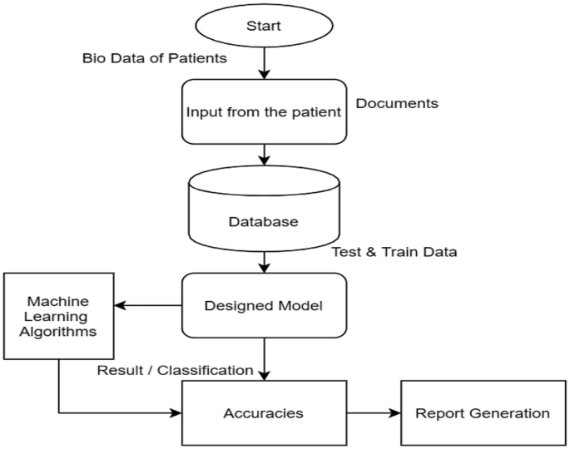
Activity Diagram

Slide 6
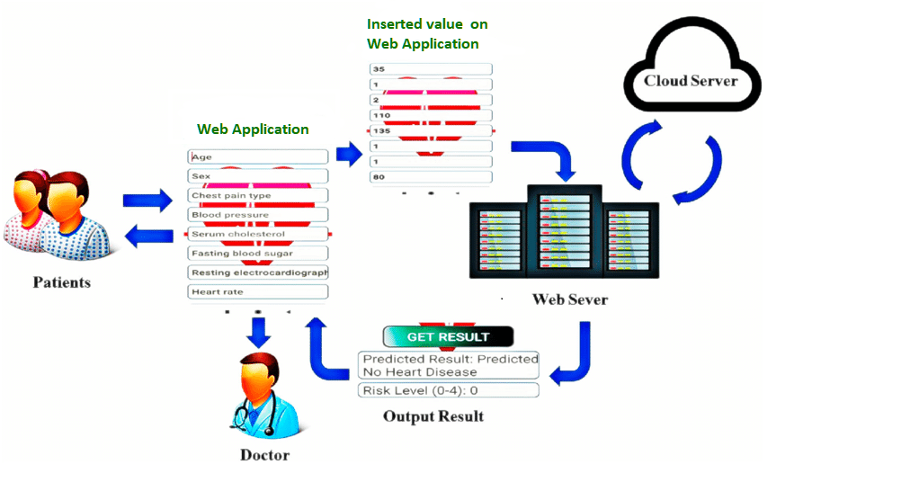
Project Functionality Diagram

Slide 7
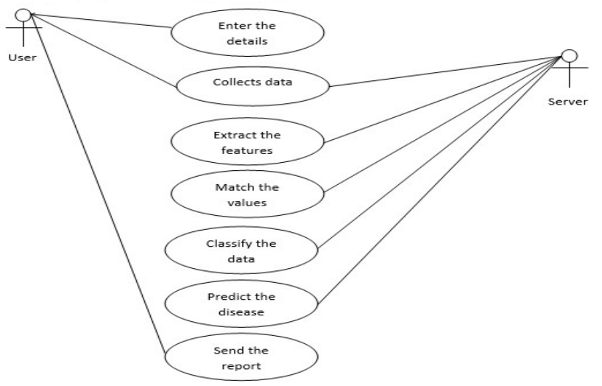
Use Case Diagram

Slide 8
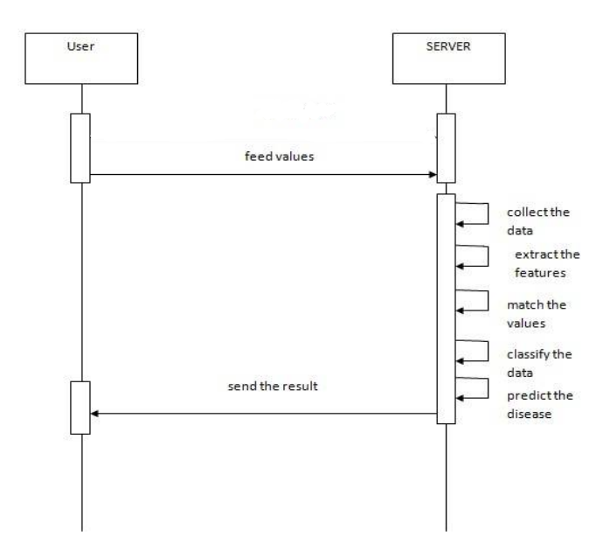
Sequence Diagram

Slide 9
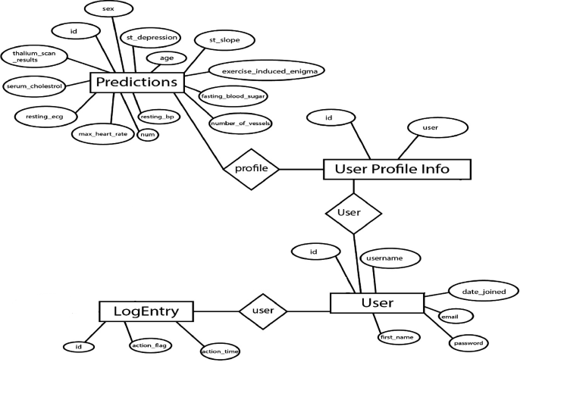
ER Diagram

Slide 10
Advantages of Application
Early prediction of heart diseases can be done
The cost of medication will be minimised
Accuracy rate will be high
High Performance

Slide 11

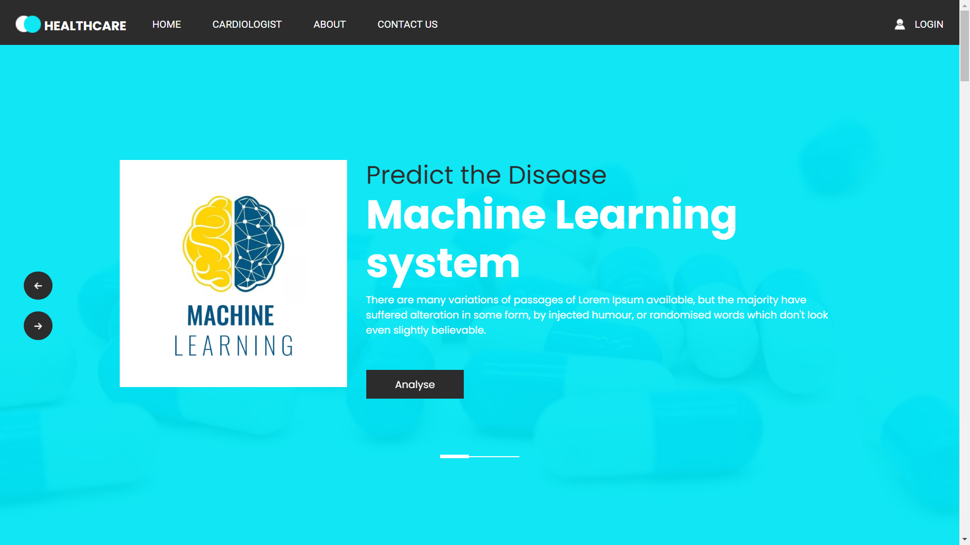
SOFTWARE DESKTOP
User Interface demo of your design that will be visible to user

Slide 12
Live code ….

Slide 13
References
M. Raihan, Saikat Mondal, Arun More, Md. Omar Faruqe Sagor, Gopal Sikder, Mahbub Arab Majumder, Mohammad Abdullah Al Manjur and Kushal Ghosh “Smartphone Based Ischemic Heart Disease (Heart Attack) Risk Prediction using Clinical Data and Data Mining Approaches, a Prototype Design”, September 2014.
Marjia Sultana, Afrin Haider and Mohammad Shorif Uddin “Analysis of Data Mining Techniques for Heart Disease Prediction”, May 2015.
Soodeh Nikan, Femida Gwadry-Sridhar, and Michael Bauer “Machine Learning Application to Predict the Risk of Coronary Artery Atherosclerosis”, IEEE, August 2016
Sanjay Kumar Sen Asst. Professor, Computer Science & Engg. Orissa Engineering College, Bhubaneswar, Odisha – India.” Predicting and Diagnosing of Heart Disease Using Machine Learning Algorithms” International Journal of Engineering and Computer Science. Volume 6 Issue 6, June 2017
V.V. Ramalingam, Ayantan Dandapath, M Karthik Raja “Heart disease prediction using machine learning tech : A survey” International Journal of Engineering & Technology, 7 (2.8), April 2018.
Heart Disease Dataset - https://www.kaggle.com/c/heart-disease dated: Sept 2018
K. Srinivas, B. Kavihta Rani, A. Govrdhan “Applications of Data Mining Techniques in Healthcare and Prediction of Heart Attack” IJCSE) International Journal on Computer Science and Engineering Vol. 02, No. 02, 2010.
Heart Disease Data Set https://archive.ics.uci.edu/ml/datasets/heart+Disea

Slide 14
S.Bhagavathy, V.Gomathy ,S.Sheeba Rani, Sujatha.K, “Early Heart Disease Detection Using Data Mining Techniques with HadoopMapreduce”, International Journal of Pure and Applied Mathematics, 119(12), 1915-1920, 2018.
Syed Umar Amin, Agarwal, K., & Beg, R., “Genetic neural network based data mining in prediction of heart disease using risk factors”, IEEE Conference in Information & Communication Technologies (ICT), 1227-1231, 2013. 6. S. Shilaskar and A. Ghatol, “Feature selection for medical diagnosis : Evaluation for cardiovascular diseases,” Expert Syst. Appl., vol. 40, no. 10, pp. 4146–4153, Aug. 2013.
Purusothaman, G., &Krishnakumari, P. “A survey of data mining techniques on risk prediction: Heart disease”, Indian Journal of Science and Technology, 8(12), 1, 2015. 8. Miao, K. H., Miao, J. H., & Miao, G. J. (2016), “Diagnosing Coronary Heart Disease Using Ensemble Machine Learning”, International Journal of Advanced Computer Science and Applications, 7(10), 30-39, 2016. 9. Dbritto, R., Srinivasaraghavan, A., & Joseph, V., ”Comparative Analysis of Accuracy on Heart Disease Prediction using Classification Methods”, International Journal of Applied Information Systems (IJAIS)–ISSN, 2249-0868, 11(2), 2016

Slide 15

Thank You

